Slide 1
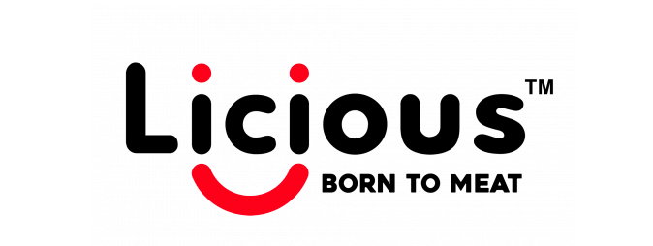
E- COMMERCE PROJECT ON
Submitted By:
Taksande Sandeep Ravindra
Batch : Business Analytics
PRN: 20020845030

Slide 2
Background
Licious is a meat and seafood company headquartered in Bengaluru, founded in 2015, serving in Food industry.
It operates on a farm-to-fork model, owning the entire back-end supply chain and cold chain.
Currently it operates across 17 cities in India serving meat, sea food, ready to cook and ready to eat meal.
Licious has 5 processing centers, one of each in Hyderabad, Mumbai, Gurugram and 2 in Bengaluru.
It operates at more than 90 delivery centers across all markets.
The company owns and operates the entire back-end supply chain, and controls a stringent cold chain to maintain the quality and freshness of its products.

Slide 3
Industry Background (Food Industry)
Accounting for about 32 per cent of the country’s total food market, The Government of India has been instrumental in the growth and development of the food processing industry. The government through the Ministry of Food Processing Industries (MoFPI) is making all efforts to encourage investments in the business.
It has approved proposals for joint ventures (JV), foreign collaborations, industrial licenses, and 100 per cent export oriented units.
The Indian food and grocery market is the world’s sixth largest, with retail contributing 70 per cent of the sales. The Indian food processing industry accounts for 32 per cent of the country’s total food market, one of the largest industries in India and is ranked fifth in terms of production, consumption, export and expected growth. It contributes around 8.80 and 8.39 per cent of Gross Value Added (GVA) in Manufacturing and Agriculture respectively, 13 per cent of India’s exports and six per cent of total industrial investment.
The Confederation of Indian Industry (CII) estimates that the food processing sectors have the potential to attract as much as US$ 33 billion of investment over the next 10 years and also to generate employment of nine million person.

Slide 4

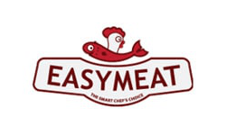

Competition Landscape
FreshToHome
Headquarter - Bengaluru
Founded Year – 2015
Industry – Meat, Poultry and Fish
Generates 22% the revenue of Licious
EasyMeat
Headquarter – Pune
Founded Year – 2015
Industry – Food and Grocery Retail
Has 3450 fewer employees compared to Licious
ZappFresh
Headquarter – Delhi
Founded Year – 2015
Industry – Meat, Poultry and Fish
Generates $74,9M less revenue than Licious

Slide 5
Strategic Positioning
According to the founder, The most important metric in the market is ‘repeat’. 90% of the business comes from our repeat customers.
In Bangalore, 70% of new traffic comes from word of mouth and in Delhi its in mid-stage. The company have recently launched a relationship module for frequent buyers called 'priority desk'.
The premium customers will get a relationship manager, and any issues starting from placing an order to delivery of the products will be handled by this relationship manager. It has given brilliant results in the last 2 months.
They have launched it for 5000 super users in the first stage and their plan is to take it to at least 50,000 users in the next 12 months.
The company is also focused on online and social media marketing.
The Research and Development team believes in innovation as the core strength. R&D is spread across everything from 'farm to fork'.
The company are ready to innovate with technology across the supply chain, a cold chain where we use technology such as IoT, AI etc. Also, they use intelligent demand forecasting tools to create a certainty of available products.
They have integrated technology into research and development of our back end. Licious as a brand doesn’t compromise on the quality

Slide 6
Relevant Area for Analytics
Demand Predictability
As the product is highly perishable and the delivery time ranges between 90 and 120 minutes, the cold chain becomes critical
Demand predictability is based on the previous sales. Hence, the predictability to be more accurate/ precise to meet these demands.
An accurate data to be recorded based on the traffic that comes on the website, what people browse for, what are they clicking on, how many times they got to see the product in stock or out of stock, the times it was added to the cart, and then checked out.
Accurate Address Tracking
Out of approximately 25000 pin codes in India, 4000+ pin codes are still not recorded for the online delivery.
An accurate address tracking predictability is required which gives exact location of the consumer.

Slide 7
Tools Required
Demand planning
applies “forecasts and experience to estimate demand for various items at various points in the supply chain.” In addition to making estimations, demand planners take part in inventory optimization, ensure the availability of products needed, and monitor the difference between forecasts and actual sales.
serves as the starting point for many other activities, such as warehousing, shipping, price forecasting, and, especially, supply planning that aims at fulfilling the demand and requires data on the anticipated needs of customers.
Accurate Address Tracking
The Google Analytics location report can be put to good use. Tracking user location in Google Analytics is very useful for understanding your audience, which helps with tailoring the marketing and advertising strategy.

Slide 8
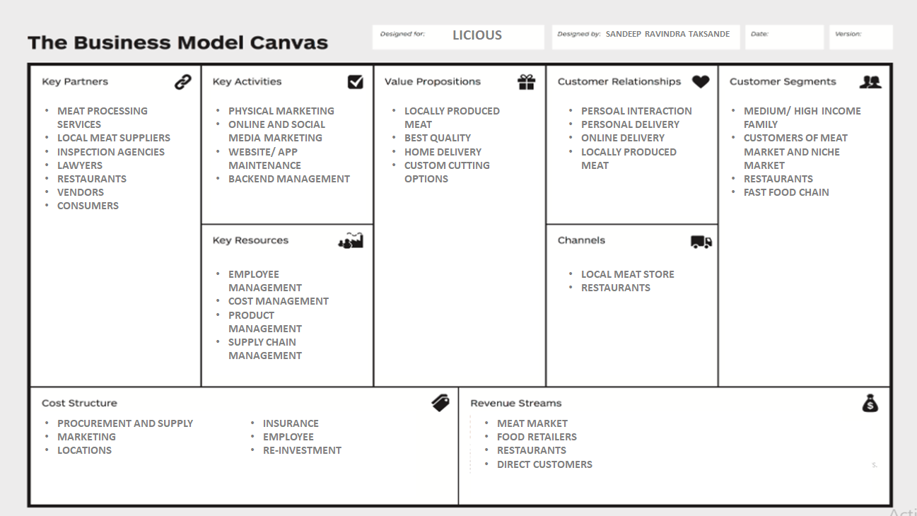

Slide 9
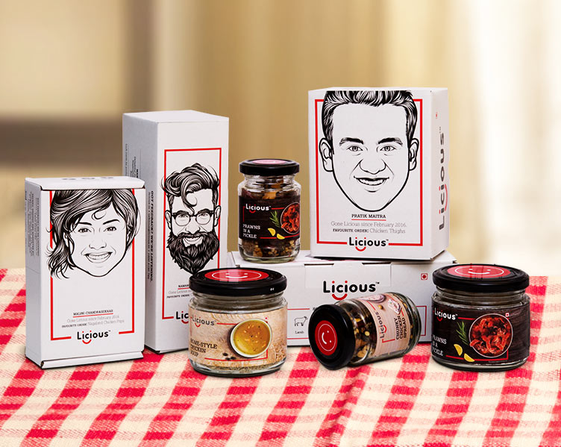
THANK YOU

